Slide 1
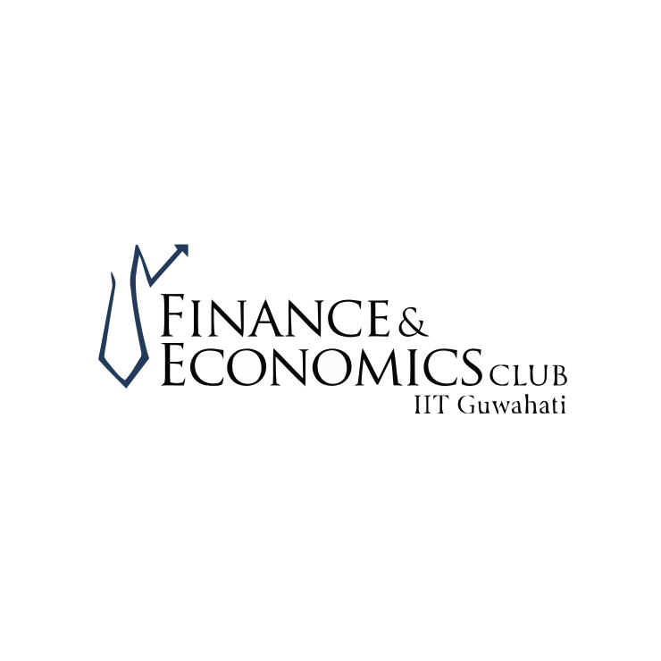



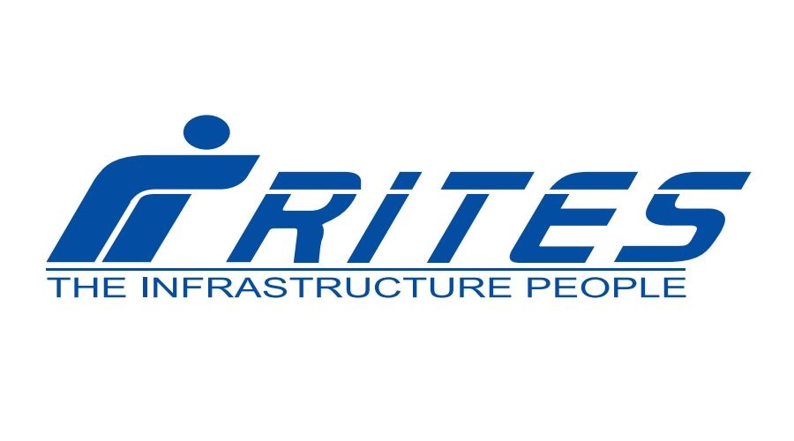


Slide 2
Shailesh Mishra
m.Shailesh@iitg.ac.in
9306548556
Shruti Kayal
k.shruti@iitg.ac.in
9547007725
Shreyas Kumar
k.Shreyas@iitg.ac.in
7389537458
Shreya Sen
s.sen@iitg.ac.in
8420124778
MEET THE TEAM
Tanishq Singh
tanishq@iitg.ac.in
8287643047

Slide 3

TABLE OF CONTENTS
Reasons to choose RITES
Company Overview
Competitors Analysis
Financial Analysis
Investment Risks and Threats
Conclusion
Appendix

Slide 4
Reasons to choose RITES
Exposure to commodity prices
The need for natural resources is increasing day by day, therefore increasing its market value .So if the commodity price rises it can positively impact the agency as well as their shareholders.
Potential for high returns
As huge reserves of silicon is discovered in the exclusive economic zone of the Indian Ocean, which leads to substantial capital growth.
Independence
By investing in Silicon mining, companies to have more control over their supply chain and reduce dependence on external suppliers.
Geopolitical Considerations
The location of mining operations can impact investment decisions. Investing in mining companies with operations in politically stable regions with favorable mining regulations and infrastructure can provide a sense of security and minimize certain risks associated with geopolitical uncertainties.
Hedge against inflation
Commodities, including metals and minerals, have historically acted as a hedge against inflation. When inflation rises, the prices of commodities tend to increase as well, which can benefit mining companies and their shareholders.

Slide 5
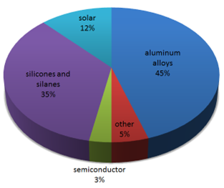
Reasons to choose
RITES
Growing demand for aluminium silicon (Al-Si) alloys from industries such as automotive, construction, aerospace, and marine is the major driver of silicon metal market
Aluminium dominated the silicon metal market and accounted for a share of 44% in 2019, owing to its extensive utilization of silicon metal as an alloying agent in aluminium production.
Factors such as growing demand for aluminium alloys, silicon wafers, solar panels, and silicone products from various end-use industries such as automotive and electronics are major factors boosting the silicon metal market growth

Slide 6
RITES Limited, is a Company under the Ministry of Railways, and was incorporated on April 26, 1974. It provides a comprehensive range of services from concept to commissioning in every aspect of transport infrastructure and related technologies.
COMPANY OVERVIEW
RITES is a leading player in the transport consultancy and engineering sector in India and uniquely placed in terms of diversification of services and geographical reach in various sectors such as railways, highways, urban engineering (metros) & sustainability, airports, ports, ropeways, institutional buildings, inland waterways, and renewable energy. It is the only export arm of Indian Railways for providing rolling stock, other than Thailand, Malaysia, and Indonesia.
RITES success story spans over 48 years covering more than 55 countries. It also became a listed company in July 2018, and it has made it to the Top-500 listed Indian companies according to market capitalization.
RITES has been maintaining healthy ROE of 20.81% over the past 3 years and it has been maintaining healthy ROCE of 28.39% over the past 3 years.
It is virtually debt free and has a healthy Interest coverage ratio of 137.

Slide 7
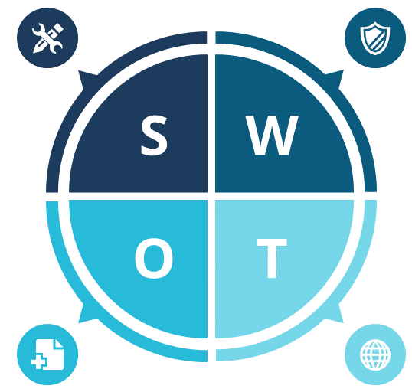
SWOT ANALYSIS
Strengths
RITES is a leading company in multidisciplinary engineering and transport consultancy.
It is the only export arm of Indian Railways for providing rolling stock(other than Thailand, Malaysia, and Indonesia)
RITES has been maintaining healthy ROE of 20.81% over the past 3 years.
Weakness
Decline in Net Profit due to falling Profit Margin
There is a decline in net cashflow.
It is a mid-range performer.
Opportunities
It has a good geographical reach and provides varied services in several sectors such as railways, highways, urban engineering (metros) & sustainability, airports, ports, ropeways, institutional buildings, inland waterways, and renewable energy.
Threats
Increasing competition in market puts pressure on sales and revenue.
Negative social media reviews can harm company reputation.
4

Slide 8
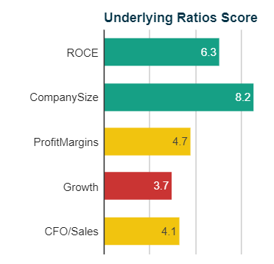
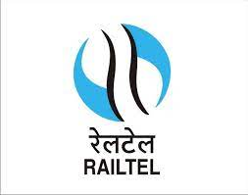
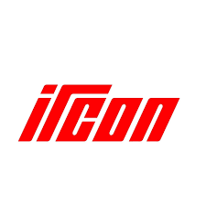
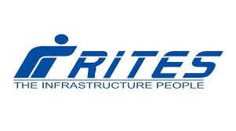
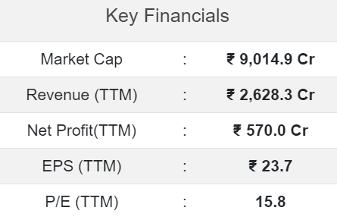
Competitors Analysis
P/E (%) : 9.83
Net Profit QTR (Rs. Cr) :
256.49
Market Cap. (Rs. Cr) : 7,519.42
P/E(%) : 16.99
Net Profit QTR (Rs. Cr) :
138.89
Market Cap. (Rs. Cr) : 9014.93
P/E (%) : 20.26
Net Profit QTR (Rs. Cr) :
76.04
Market Cap. (Rs. Cr) : 4085.24
1
1
1
2
2
2
3
3
3

Slide 9
Competitors Analysis
Integration with Indian Railways
RITES is a subsidiary of Indian Railways, the national railway system of India. This affiliation provides RITES with a unique advantage as it has access to the vast resources, expertise, and network of Indian Railways, enabling it to leverage this association for project execution.
Technological expertise
Professional workforce
RITES stays updated with the latest technological advancements in the transportation infrastructure sector. This expertise allows RITES to incorporate innovative solutions, best practices, and advanced technologies into its project designs and implementations, ensuring efficient and sustainable infrastructure development.
RITES boasts a skilled and experienced workforce comprising engineers, architects, project managers, and other professionals. The company invests in training and development programs to continuously upgrade the skills of its employees, ensuring the delivery of high-quality services.
Financial stability
RITES has a stable financial position due to its government ownership and a consistent track record of revenue generation. This stability provides confidence to clients, lenders, and project partners, strengthening RITES' position in the market.

Slide 10

FINANCIAL ANALYSIS
RITES has boosted its EBIT by 51%, thus reducing the spectre of future debt repayments.
Rites is a good value based on price to earnings ratio=16.6x(5.4b -earning,price-91.54b)compared to average 39.2x of peers.
'The biggest investment risk is not the volatility of prices, but whether you will suffer a permanent loss of capital.'
We note that RITES Limited does not have debt on its balance sheet.
Rites is debt free.
No debt compared to last 5 years when debt to equity ratio was 2.8%
No debt , thus no need to be covered by operating cash flow and coverage of interests is not a concern.

Slide 11
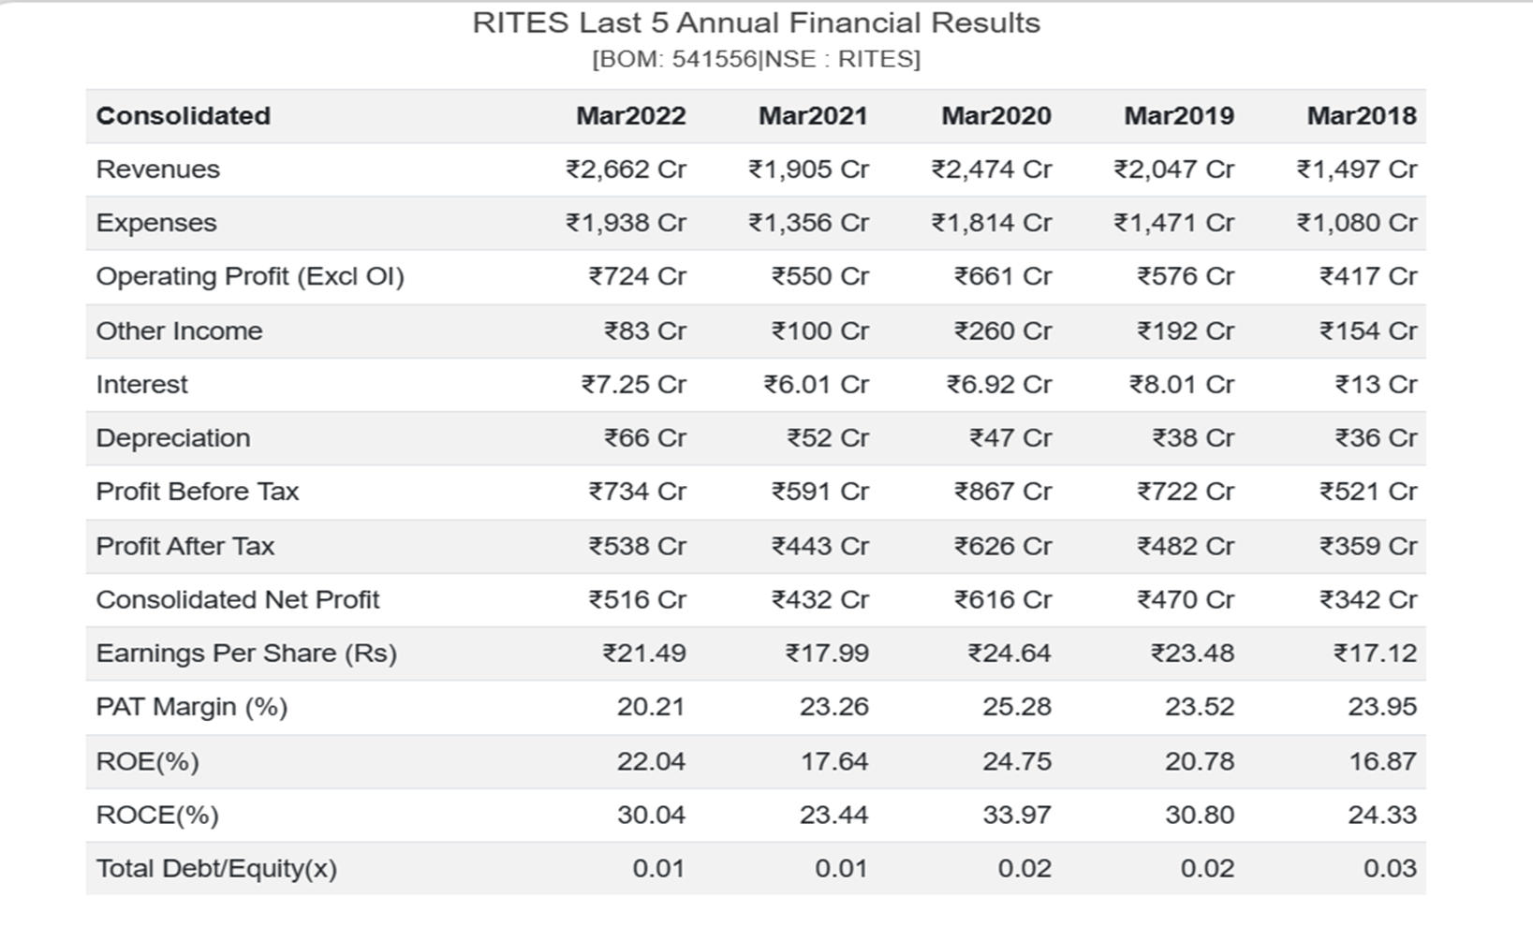
Financial Analysis

Slide 12
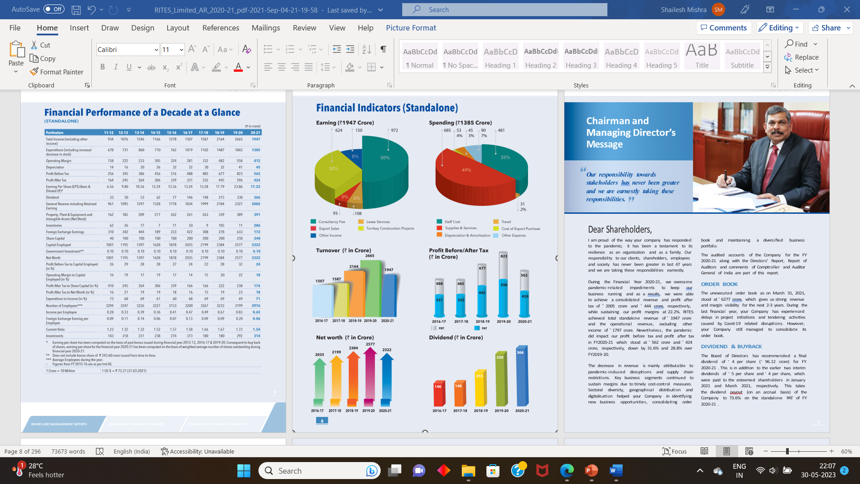
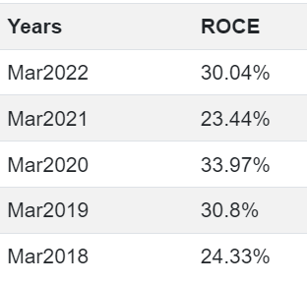
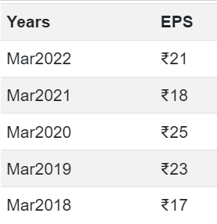

Slide 13
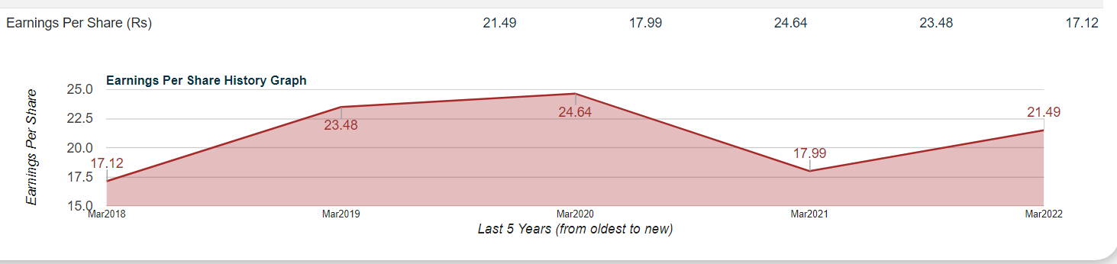
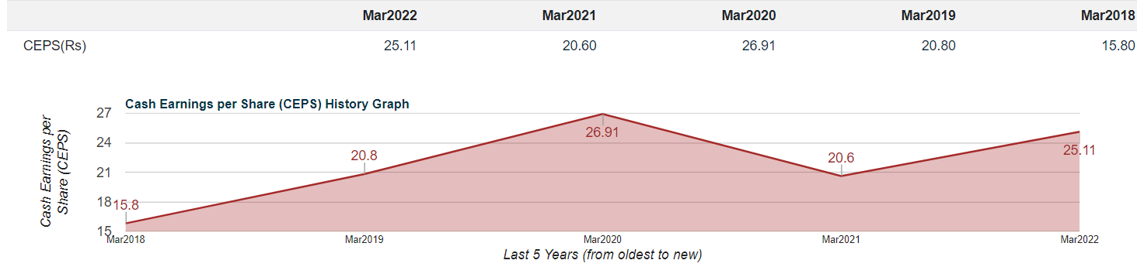
 | Mar2022 | Mar2021 | Mar2020 | Mar2019 | Mar2018
Earnings Per Share (Rs) | 21.49 | 17.99 | 24.64 | 23.48 | 23.48
CEPS(Rs) | 25.11 | 20.60 | 26.91 | 20.80 | 15.80
Tax Rate(%) | 26.76 | 25.08 | 27.82 | 33.29 | 31.12

Slide 14
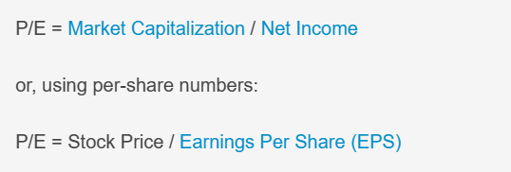
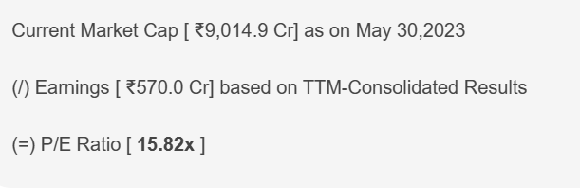
Financial Ratios
Price/Earning Ratio
P/E Ratio indicates the multiple of earnings investors are willing to pay to own one share of the company. Thus, for RITES , the investors are currently willing to pay 15.82 times earnings to own 1 share of the company. PE Multiples are the most widely used valuation multiple in practice. Since P/E ratio uses Net Income in the calculation, P/E multiples are not always reliable for valuing companies with negative earnings.

Slide 15
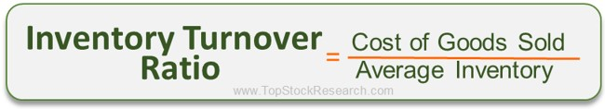

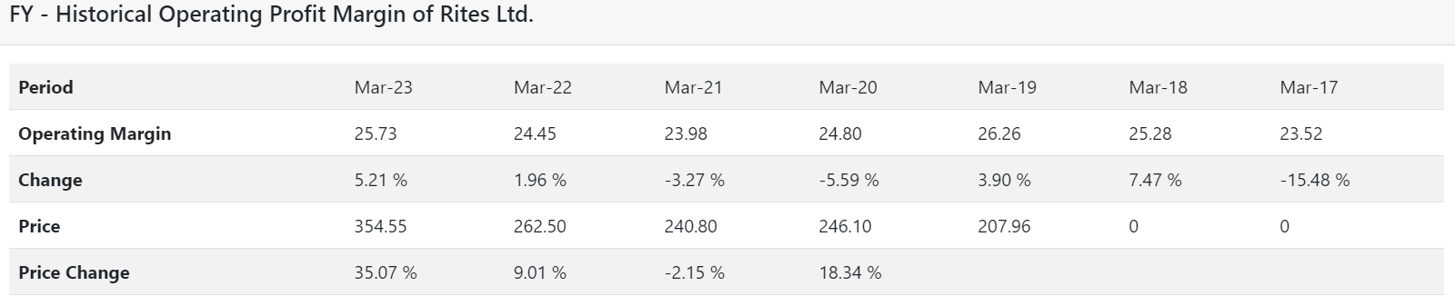
INVENTORY TURNOVER RATIO , OPERATING MARGIN
For most industries, the ideal inventory turnover ratio will be between 5 and 10, meaning the company will sell and restock inventory roughly every one to two months.
Inventory Turnover Ratio of Rites Ltd. with value of 15.58 shows the company is selling its goods or service quickly because there is high demand for its products in market.
Inventory Turnover Ratio of RITES rose handsomely by 158.25 % this year.
Inventory Turnover Ratio of RITES rose handsomely by 158.25 % this year.

Slide 16
INVESTMENT RISKS AND THREATS
Competitive Landscape: Increased competition from existing competitors(HINDALCA) or new entrants in the market can impact the company's market share, pricing power, and profitability.
Technological Disruption: Rapid advancements in technology can disrupt traditional business models and processes. Failure to keep up with technological changes can leave the company at the competitive disadvantage.
For eg. Fibreglass is used now as an alternate to alluminium sillicon alloy
Supply Chain Disruptions: Any disruptions or delays in the supply chain, such as shortages of raw materials, logistical issues, or dependencies on single suppliers, can impact the company's production capabilities and delivery timelines.

Slide 17

CONCLUSION
RITES, with its expertise in project management, strong government support, technological advancements, and strategic advantages, presents a compelling investment opportunity in silicon mining. By diversifying its revenue streams, leveraging its existing resources, and capitalizing on market demand, RITES can unlock significant value for investors. I recommend considering RITES as an investment to gain exposure to the promising silicon mining sector while benefitting from the company's well-established position in the infrastructure industry.

Slide 18

APPENDIX
https://www.topstockresearch.com/rt/Financial/RITES/OperatingProfitMargin
https://www.smart-investing.in/
https://www.rites.com/
https://iide.co/case-studies/marketing-strategy-of-rites/
https://trendlyne.com/fundamentals/peer-group/92280/RITES/rites-ltd/

Slide 19


